Slide 1
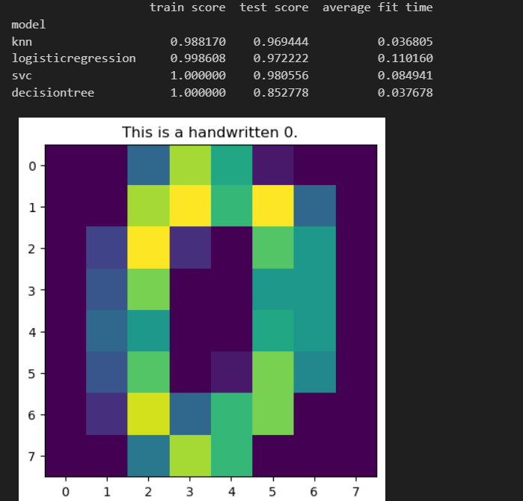
KNN: it seems to be faster for training score, but low in the fit time with 0.03.
-it will be hard to explain
-does not support large datasets
-non parametric
Logistic Regression: it is training fast at 0.11 seconds, better than the 0.03 for the KNN
-it is a better model as it provides coefficients
-allow for better explainability
-Needs regularization to avoid overfitting
SVC: It takes long in the training fit with 0.084 maybe because it is finding hyperplanes.
-can be understood with the kernels, but takes a long time
-it can be hard to explain
-good for non linear
Decision Tree: It is fast similar to the KNN with 0.03 seconds.
-Easier to interpret and visualize
-Can overfit if it is complex
-Good for non linear

